Slide 1
MulticulTUral books: critical for all children
Lora Hyler
http://www.lorahylerauthor.com
March 25, 2018

Slide 2
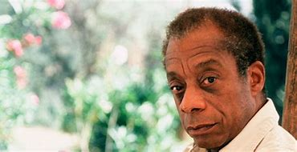
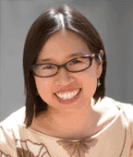
“I didn’t know I was absent until I saw myself.”
- James Baldwin
“Take a look at your child’s bookshelf. Are the books windows or mirrors?”
- Grace Lin
“There was no one who looked like me in the books I loved.”
- Grace Lin

Slide 3
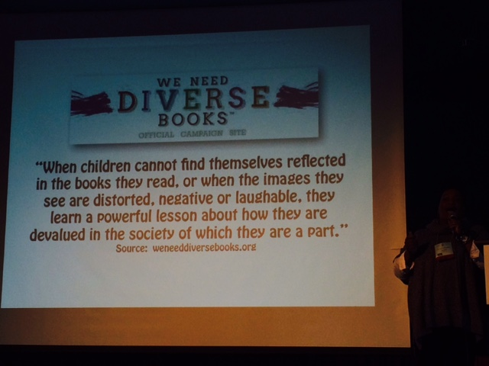
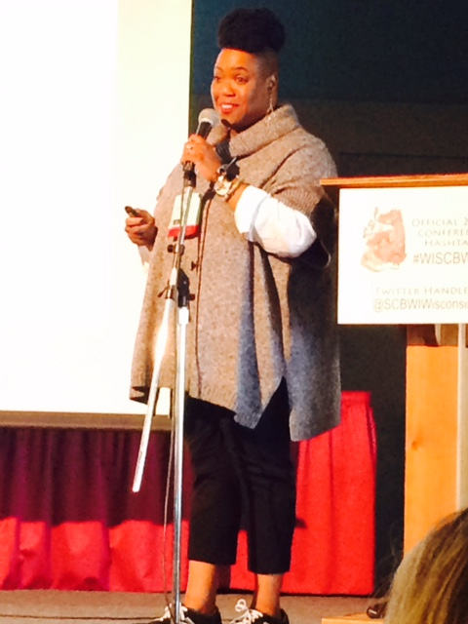
Nationally renowned illustrator vanessa Brantley newton
Notes:
Vanessa Brantley Newton is an awesome illustrator who attended SCBWI’s conference in 2016.
She has illustrated xx books.
Vanessa tells a very moving story about growing up and not seeing herself in the pages of a book.
Then one day she receives The SNOWY DAY by Ezra jack Keats.
Keats was a Polish Jew living in Brooklyn, NY and would watch the children of the neighborhood at play.
The Snowy Day showed Vanessa a little boy who looked a lot like her in a snowsuit.
She vowed to become an illustrator ad depict all types of diversity.

Slide 4

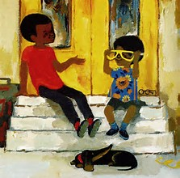
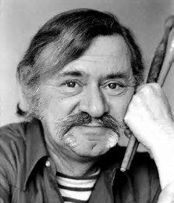
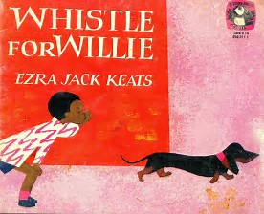
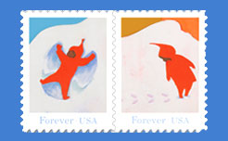
Ezra jack keats
Notes:
The Snowy Day has been immortalized.
The Snowy Day Forever
The U.S. Postal Service has issued a set of four stamps in honor of The Snowy Day. The stamps,v which feature favorite scenes of Peter playing in the snow, debut October 4.
The Snowy Day was written in 1962.
I purchased a copy for my little brown boy. That kid is now 21 years old and I still have my copy.

Slide 5
Changing demographics of america
By 2050, we will have an additional 100 million Americans
U.S. fertility rate is 50% higher than Russia, Germany, Japan, China, Italy, Singapore, South Korea
Immigration will continue to be a major force in U.S. life
By 2050, whites will no longer be in the majority within U.S. population.
U.S. minority population, currently 30% is predicted to be greater than 50% by 2050.
Smithsonian magazine, August 2010

Slide 6

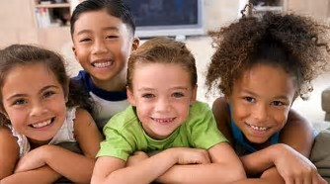
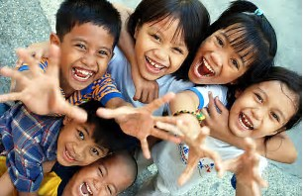
America’s children

Slide 7
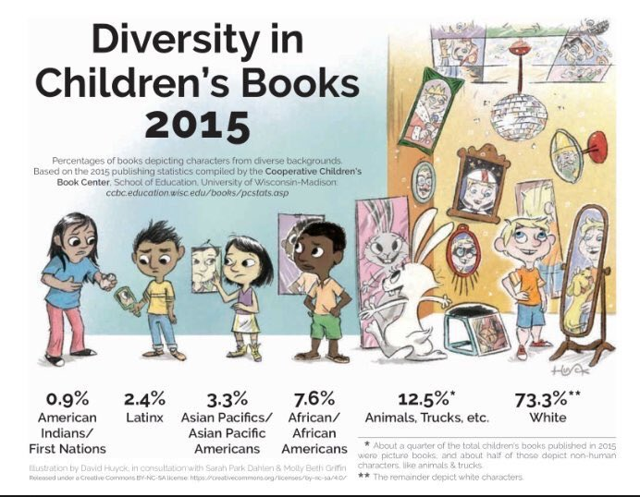
Work remains to be done
CoOPerative children’s book center, Madison, WI
“Publishing for children and teens has a long way to go before reflecting
the rich diversity of perspectives and experiences within and across race
and culture.”
Notes:
This slide depicts the current state of children’s publishing.
We discussed earlier changing demographics. So you may have guessed that diversity in children’s books was well in hand.
Here’s the reality.
Share story of major publishing house staffer who appeared at a conference here and when asked about diversity in their books, recounted how ‘woodland creatures’ by definition meant diversity.

Slide 8
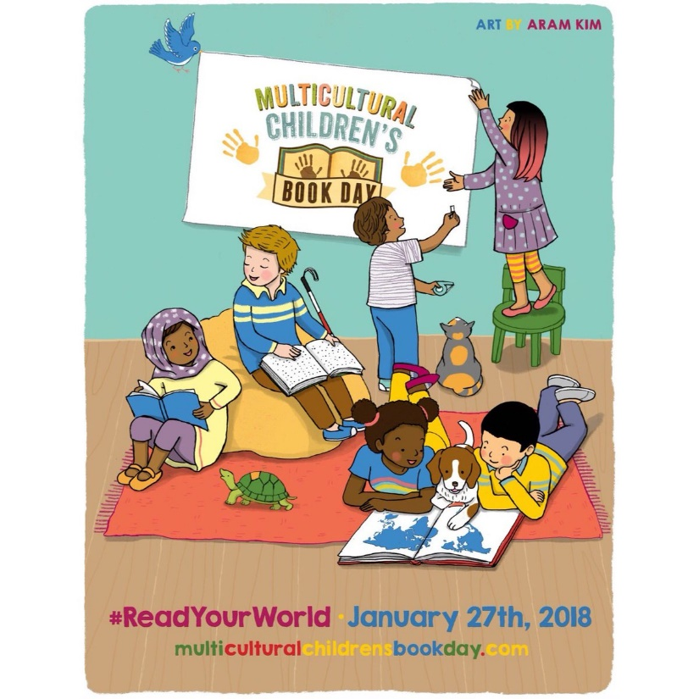
Multi-Cultural children’s book day a response to the 30 million word gap i.e. low income children hear 30 million fewer words by age three than high income children.
- had 3.6 billion social media share impressions for the day
Review
“Content does matter, and we know that the more children read—especially about themselves—the better the odds are to close the achievement gap.”
“It’s time for the publishing industry to catch up with reality and maybe Multicultural Children’s Book Day will be the catalyst.”
- Renee Prewitt-Author and CEO of Prewitt Group
Notes:
Our total social media shares for three days of our 2017 event (day before, day of and day after Multicultural Children’s Book Day) were an astounding 3.6 BILLION!
Multicultural Children’s books are:
Books that contain characters of color, as well as characters that represent a minority point of view.
Books that share ideas, stories, and information about cultures, race, religion, language, and traditions.
Books that embrace our world, and offer children new ways to connect to a diverse and richer world.

Slide 9
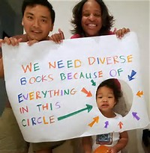

We need diverse books movement https://diversebooks.org/
Notes:
Our Mission
Putting more books featuring diverse characters into the hands of all children.
Our Vision
A world in which all children can see themselves in the pages of a book.
How we define diversity:
We recognize all diverse experiences, including (but not limited to) LGBTQIA, Native, people of color, gender diversity, people with disabilities*, and ethnic, cultural, and religious minorities.
Their programs include:
Grants
Contests
Mentorships
NICOLA YOON. Bestselling author

Slide 10
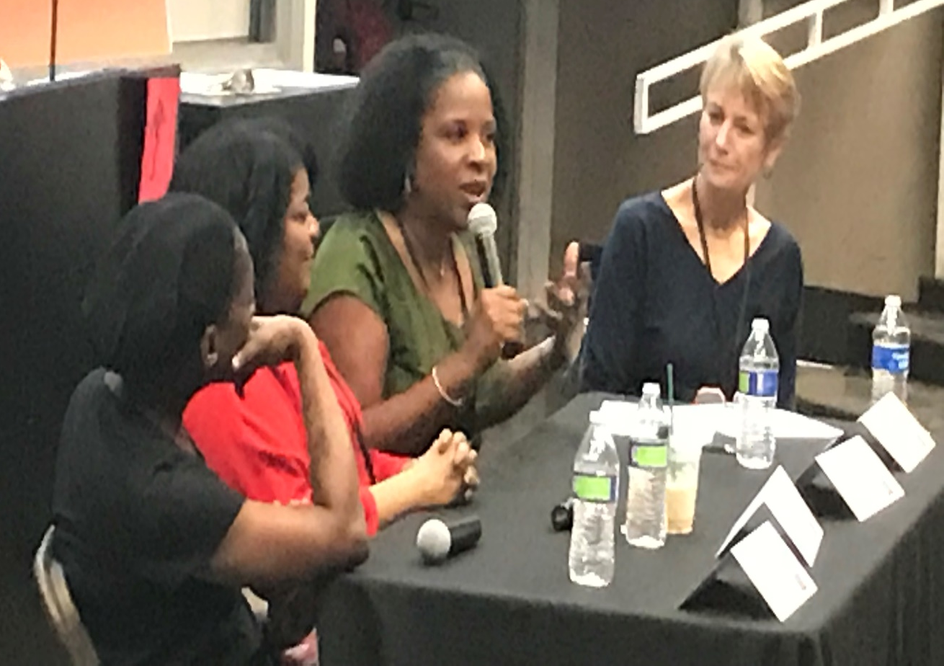
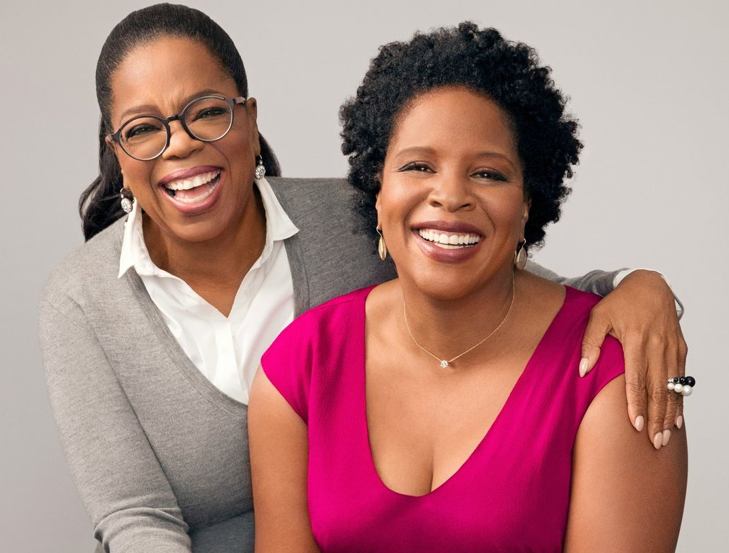
“I started writing this book to change the world.”
- Tayari Jones, An American Marriage
Oprah’s Book Club Winner (current)

Slide 11
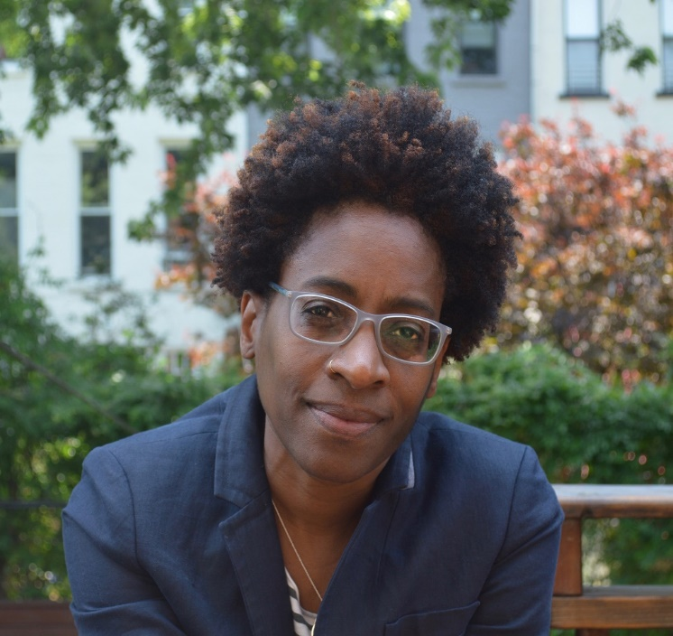
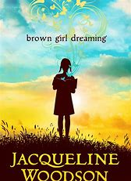
“We have the power to change the narrative.”
“Books introduce us to people we may not otherwise meet.”
- Jacqueline Woodson
Newbery Medal
National Book Award
Coretta Scott King Award for
Authors
Library of Congress National
Ambassador for Young People’s
Literature

Slide 12
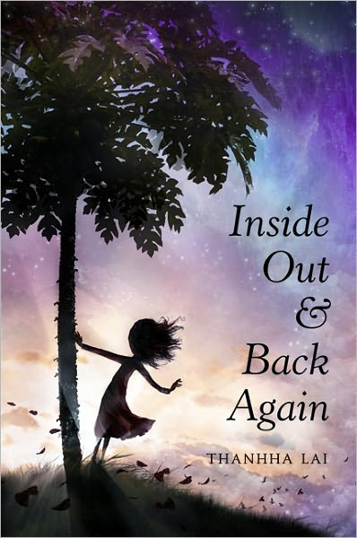
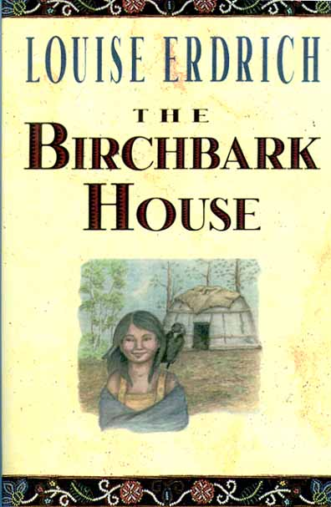
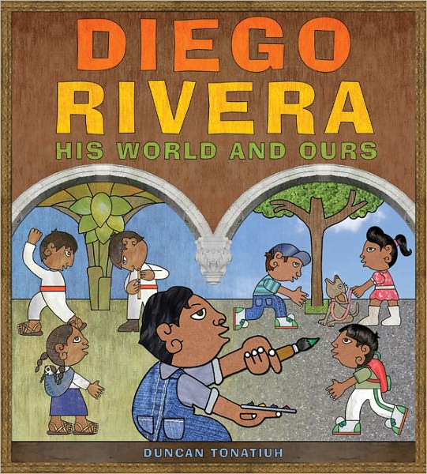
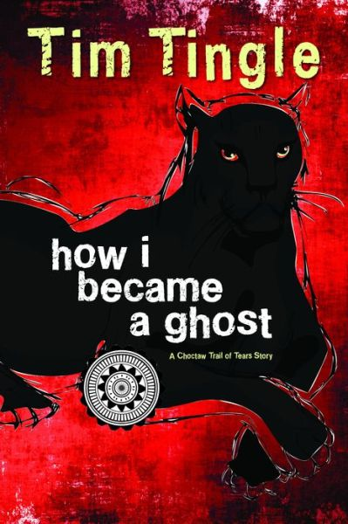
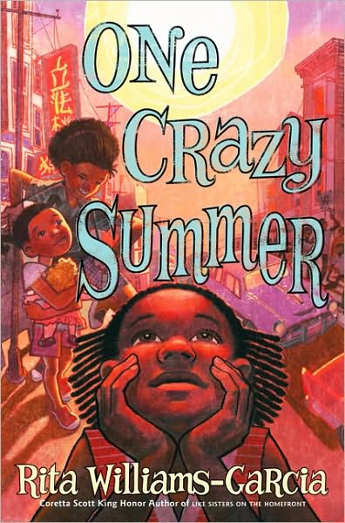
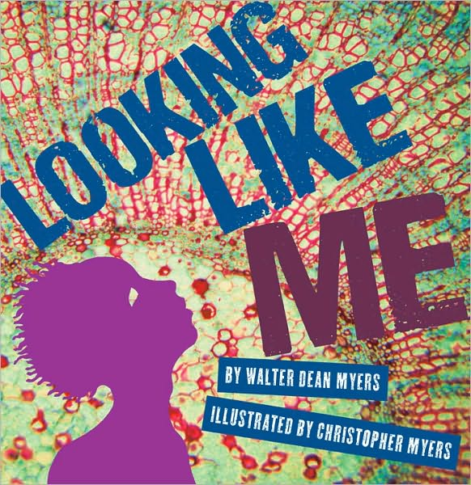
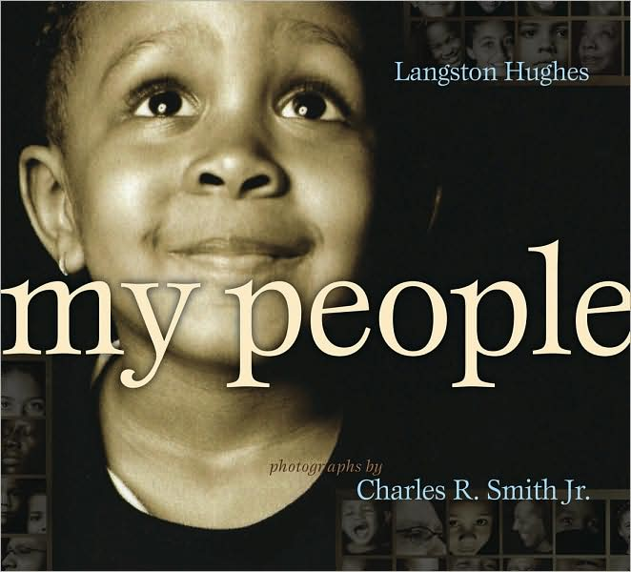
50 Multicultural books every child should know
http://ccbc.education.wisc.edu/books/detailListBooks.asp?idBookLists=42

Slide 13
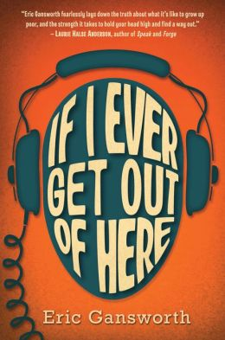

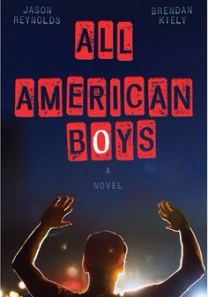


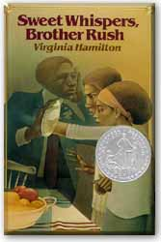

30 Multicultural books every TEEN should know
CHECK OUT CCBC’S ADVANCED SEARCH FEATURE
http://ccbc.education.wisc.edu/books/detailListBooks.asp?idBookLists=42

Slide 14
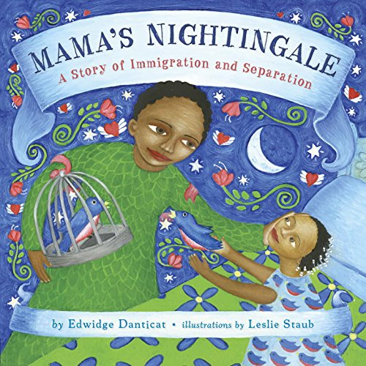
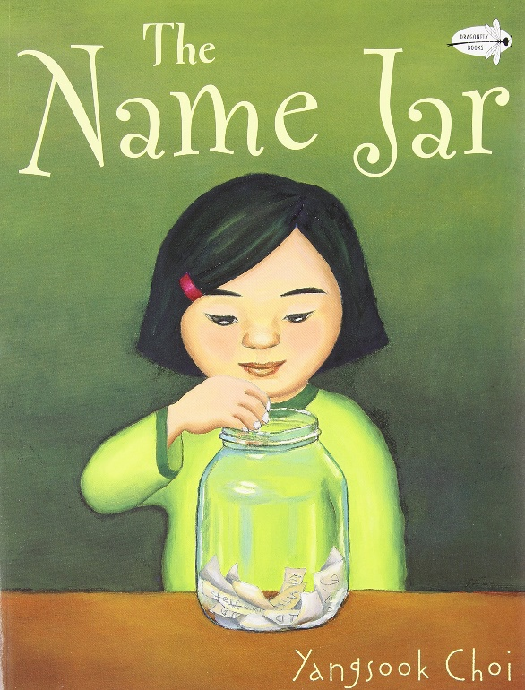
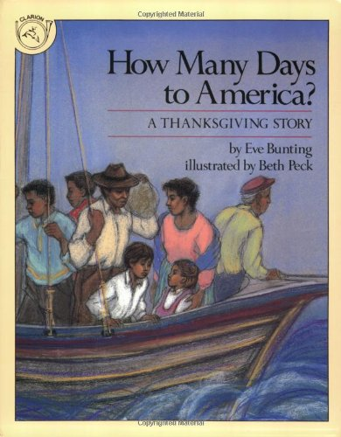
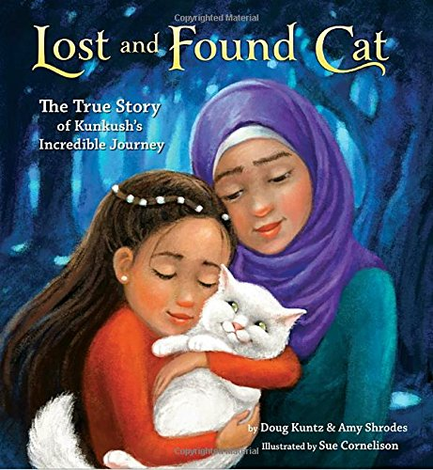
15 kids books celebrating immigration
WHOLE SECTION ON IMMIGRATION BOOKS
http://mom-gene.com/2017/09/18/15-kids-books-thaimmigration/
Notes:
Move from one country to another can be hard on kids.
15 books to help your child learn what it’s like to move to a new land.
Also teach empathy to kids in classroom who need to welcome a stranger.

Slide 15
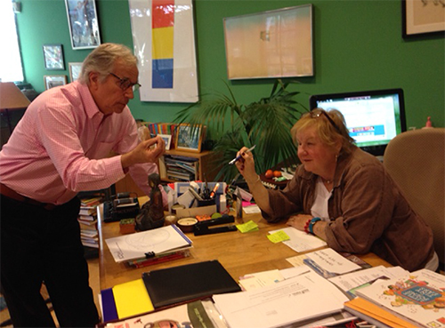

Society of children’s books writers and illustrators a GREAT RESOURCE FOR CHILDREN’S BOOKS https://wisconsin.scbwi.org/diversity-resources-for-writers-and-illustrators/
22,000 members in
70 regional chapters
SCBWI co-founder Lin Oliver and Henry Winkler
Notes:
SCBWI is the premier organization for children’s book publishing.
22,000 members in 70 regional chapters nationally and internationally.
I’m a member. We have chapters throughout the U.S.,
All over Europe, Caribbean, Hong Kong, India, Mexico, South Africa, Switzerland and many more.
Pictured here is Lin Oliver, co-founder with Henry Winkler, The Fonz. Lin is an author also and has written 30 books with Henry.
I met her for the first time in person last month as she came to Wisconsin as he keynote speaker for our WI chapter fall retreat.

Slide 16
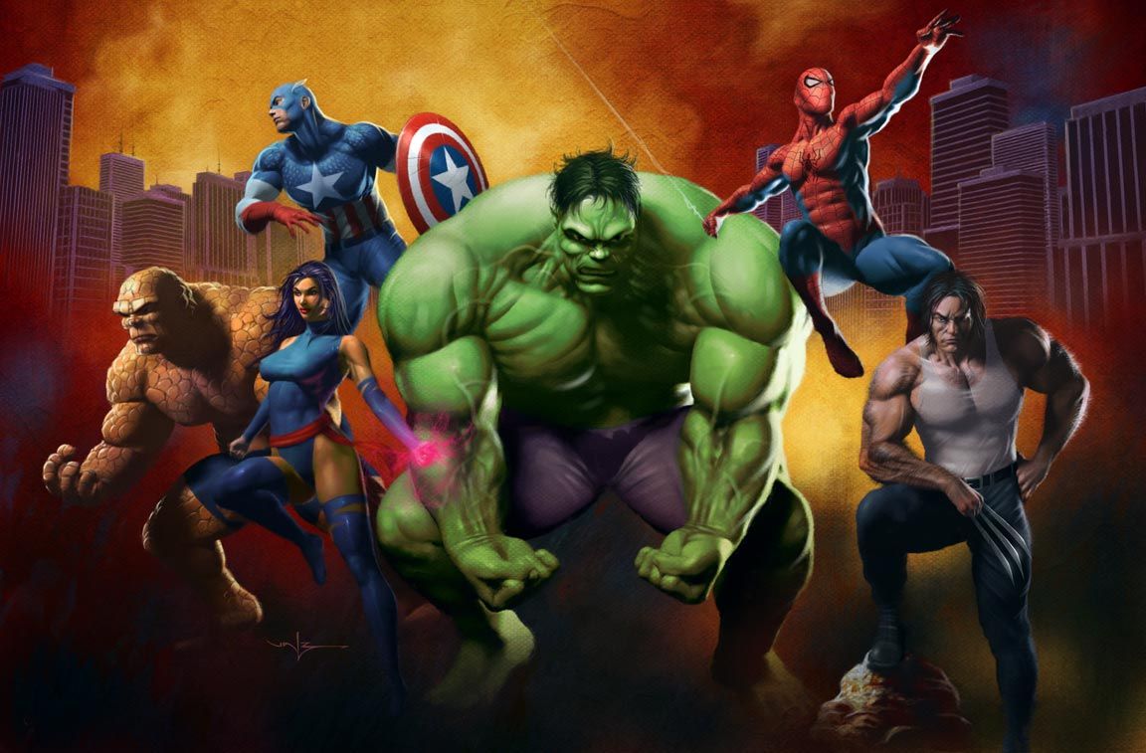
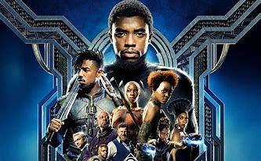
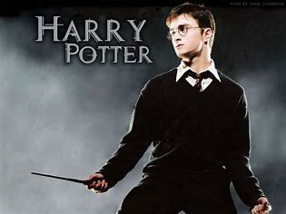
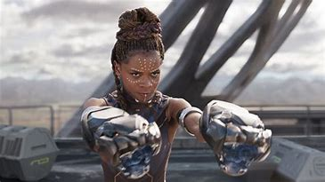

Slide 17
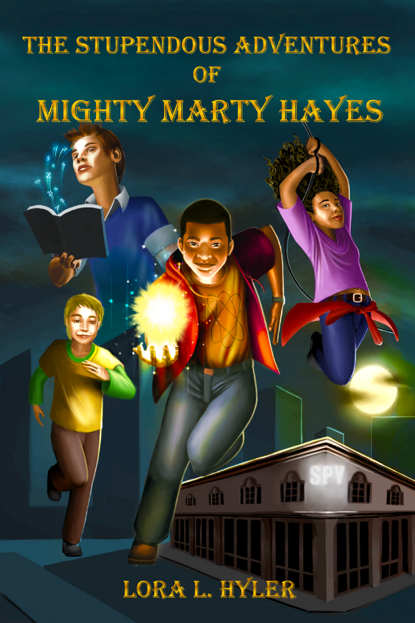
The stupendous adventures of mighty marty hayes
“An African-American tween uses espionage skills and superpowers in this debut middle-grade novel. Seventh-grader Marty Hayes is excited to work with the world-renowned CRISPR-Cas9 gene editing kit in science class. But things go awry…This rousing book with engaging characters should appeal to readers who enjoy adventurous superhero sagas. A thrilling tale with series potential that highlights science, spying, history, and the importance of family.
- Kirkus Reviews

Slide 18
Do you think only boys get superpowers?

Slide 19
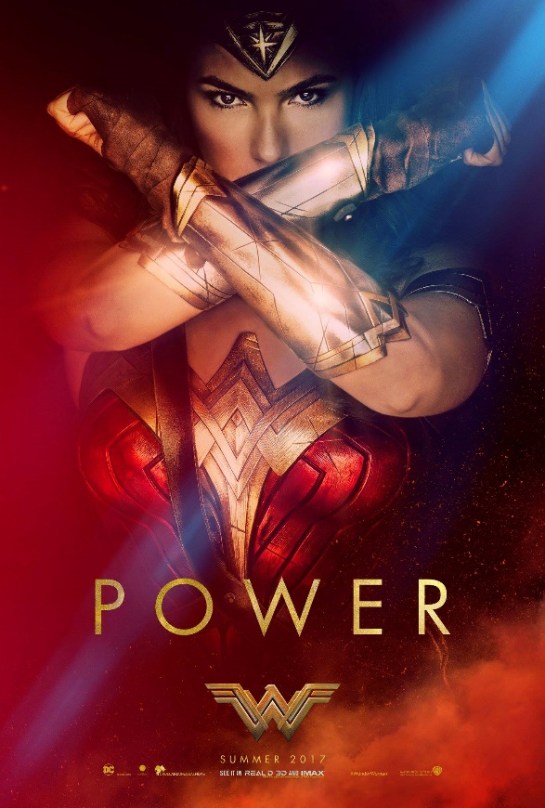
What can you DO, AS
Teacher, educator, parent, grandparent?
OK, SUPERHEROES…
Notes:
What can you do??? ‘
Discussion with Barnes and Noble bookseller—has to be careful that when a parent requests a childrens book and he sees a person of color standing in front of him that he doesn’t ASSUME that the customer wants a book of their culture. Certainly want to include in offerings.
Think about your grandchildren, your children and the world you wish to see. Order these books. Distribute them. Donate them. Become part of the solution to the divisiveness of our country
Children need to see their faces reflected in books. Our future depends on it.

