Slide 1
USING YOUR SUPERPOWER: THE AUDACITY OF WRITING CHILDREN’S BOOKS AND REFLECTING ALL CHILDREN
WRITING ON THE DOOR
LORA L. HYLER
AUTHOR: THE STUPENDOUS ADVENTURES OF MIGHTY MARTY HAYES
OWNER, HYLER COMMUNICATIONS

Slide 2
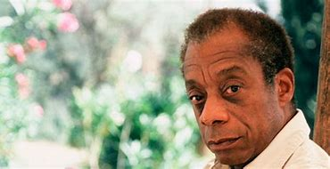

“I didn’t know I was absent until I saw myself.”
- James Baldwin
“Take a look at your child’s bookshelf. Are the books windows or mirrors?”
- Grace Lin
“There was no one who looked like me in the books I loved.”
- Grace Lin

Slide 3
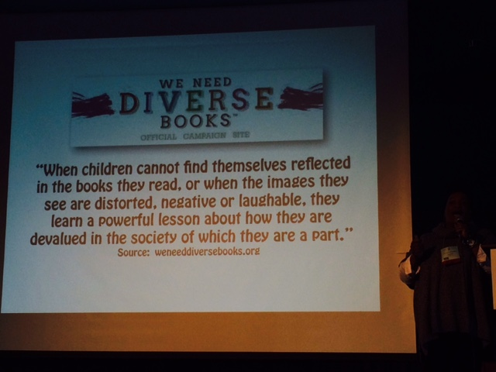
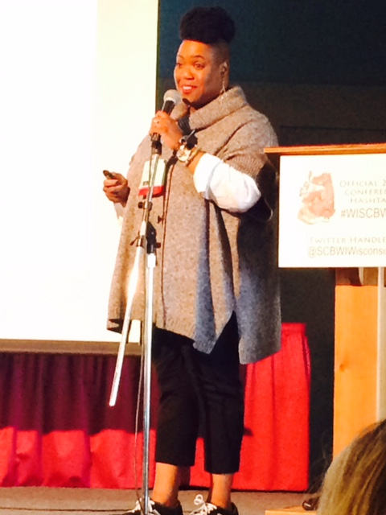
Nationally renowned illustrator vanessa Brantley newton
Notes:
Vanessa Brantley Newton is an awesome illustrator who attended SCBWI’s conference in 2016.
She has illustrated xx books.
Vanessa tells a very moving story about growing up and not seeing herself in the pages of a book.
Then one day she receives The SNOWY DAY by Ezra jack Keats.
Keats was a Polish Jew living in Brooklyn, NY and would watch the children of the neighborhood at play.
The Snowy Day showed Vanessa a little boy who looked a lot like her in a snowsuit.
She vowed to become an illustrator ad depict all types of diversity.

Slide 4
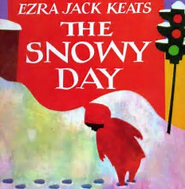
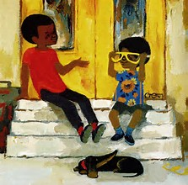
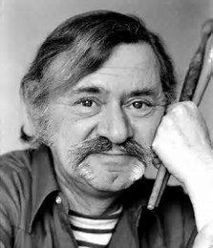

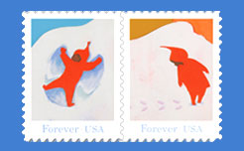
Ezra jack keats
Notes:
The Snowy Day has been immortalized.
The Snowy Day Forever
The U.S. Postal Service has issued a set of four stamps in honor of The Snowy Day. The stamps,v which feature favorite scenes of Peter playing in the snow, debut October 4.
The Snowy Day was written in 1962.
I purchased a copy for my little brown boy. That kid is now 21 years old and I still have my copy.

Slide 5
Changing demographics of america
By 2050, we will have an additional 100 million Americans
U.S. fertility rate is 50% higher than Russia, Germany, Japan, China, Italy, Singapore, South Korea
Immigration will continue to be a major force in U.S. life
By 2050, whites will no longer be in the majority within U.S. population.
U.S. minority population, currently 30% is predicted to be greater than 50% by 2050.
Smithsonian magazine, August 2010

Slide 6

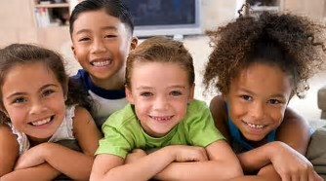
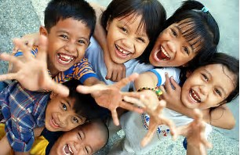
America’s children

Slide 7
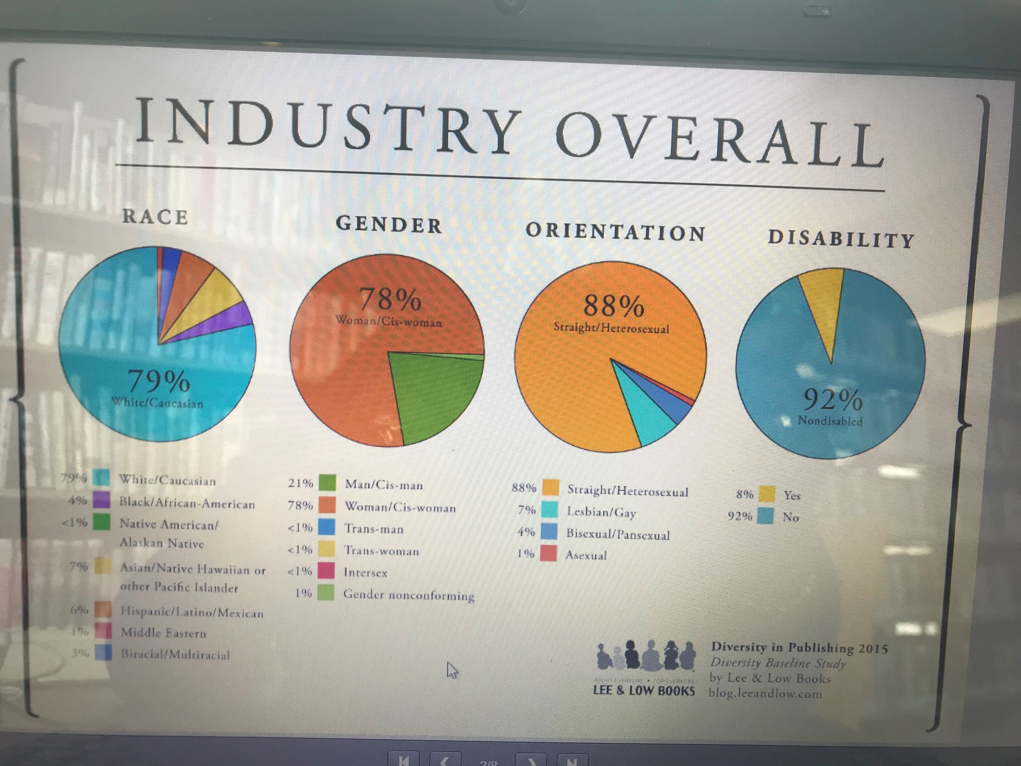

Slide 8
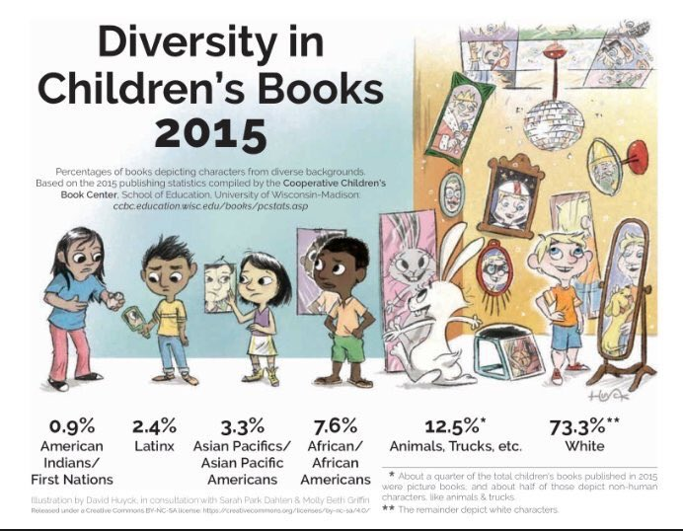
Work remains to be done
CoOPerative children’s book center, Madison, WI
“Publishing for children and teens has a long way to go before reflecting
the rich diversity of perspectives and experiences within and across race
and culture.”
Notes:
This slide depicts the current state of children’s publishing.
We discussed earlier changing demographics. So you may have guessed that diversity in children’s books was well in hand.
Here’s the reality.
Share story of major publishing house staffer who appeared at a conference here and when asked about diversity in their books, recounted how ‘woodland creatures’ by definition meant diversity.

Slide 9
Bologna Children’s Book Fair
March 26-29 bologna, italy trends from publisher’s weekly digital copy of show daily
What’s Selling?
“Issues” Books: pregnancy, illness, abuse, as catalyst to universal story about friendship
or family dynamics
Books featuring a variety of cultural influences and identity experiences, whether reality
or fantasy-based
“There’s a sea change underway in the U.S. market that’s gaining traction overseas.”
  - Director of Children’s Scouting
  Franklin & Siegal Associates, New York
  They represent foreign publishers as well as clients for feature film and television

Slide 10
bologna CHILDren’s book fair publisher’s weekly trendwatch
YA fantasy with a unique hook, still rules in U.S., particularly if from an
underrepresented author
YA crossing genres, international perspective or structure
In middle grade, heartfelt quality fiction is also in forefront in UK and
  internationally.
Non-fiction has had a “meteoric” rise in U.S. – both picture books and
  narrative non-fiction.
Stories about strong women.
- Sarah Davies, Greenhouse Literary Agency

Slide 11
bologna CHILDren’s book fair publisher’s weekly trendwatch
Internationally, series are taking off for both MG and YA
Especially, if they have non-conformist female characters.
Non-fiction
  - Jennifer Weltz
  Pres. Jean V. Naggar Literary Agency

Slide 12
bologna CHILDren’s book fair publisher’s weekly trendwatch
Strong surge of non-fiction for kids
Parents and kids getting involved in call to action and education
Due to popularity of issues-related books, such as Good Night Stories for
Rebel Girls, and The Hate U Give,
publishers are responding to:
Diversity Feminism Sexual Consent
Immigration Environment & other Social Justice Themes
- Stefanie Diaz
Director of International Rights, Sanford J. Greenburger Associates

Slide 13
bologna CHILDren’s book fair publisher’s weekly trendwatch
Having great success with MG fiction
Translates across territories
Success comes to books with heart-i.e. Wonder
Female-led fantasy
Chapter books are strong
Picture books are a challenge
China is acquiring at a steady pace
- Linda Kaplan
Director, Foreign Rights
Defiore & Co.

Slide 14
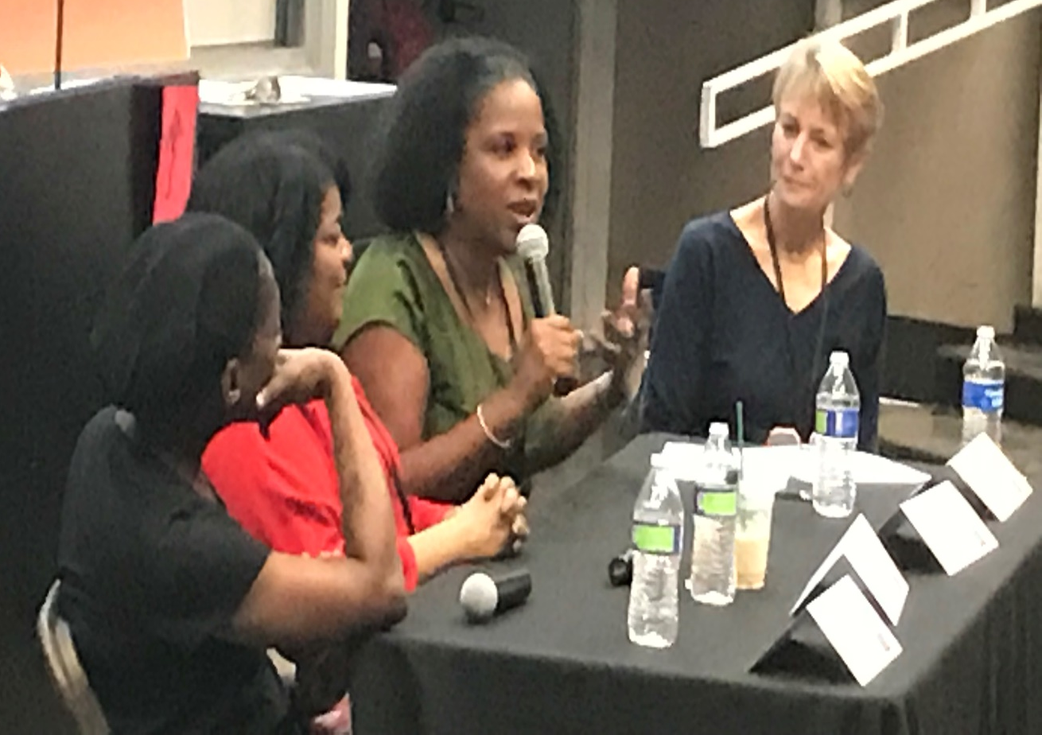
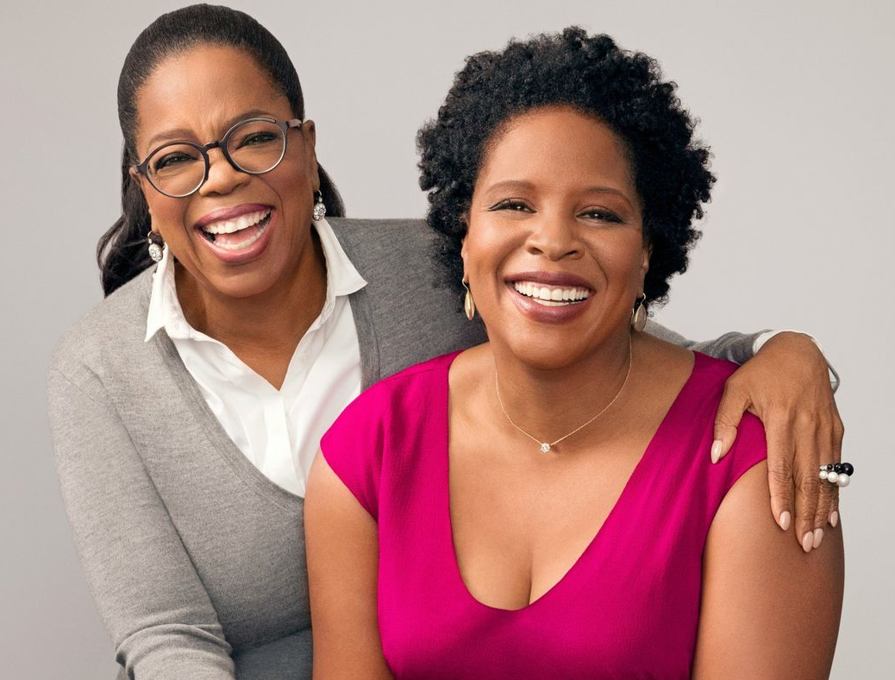
“I started writing this book to change the world.”
- Tayari Jones, An American Marriage
Oprah’s Book Club Winner (current)

Slide 15
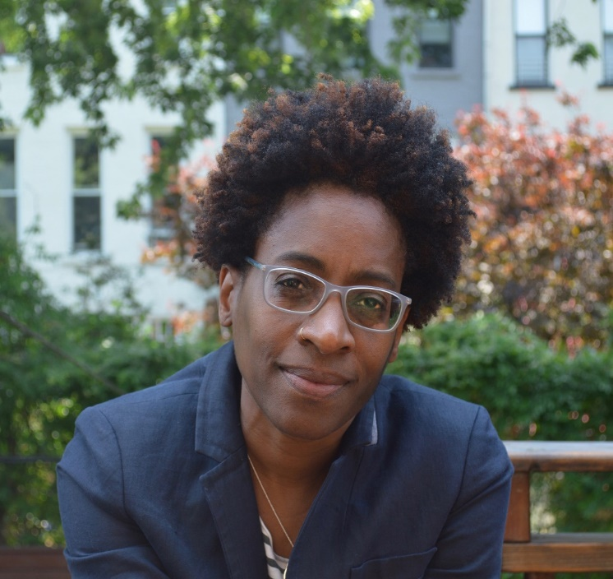
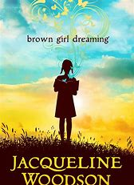
“We have the power to change the narrative.”
THE AMAZING JACQUELINE WOODSON
NAMED WINNER OF ASTRID LINDGREN MEMORIAL AWARD, CARRIES $600,000 PRIZE
“Books introduce us to people we
may not otherwise meet.”
- Jacqueline Woodson
Newbery Medal
National Book Award
Coretta Scott King Award for
Authors
Library of Congress National
Ambassador for Young People’s
Literature

Slide 16
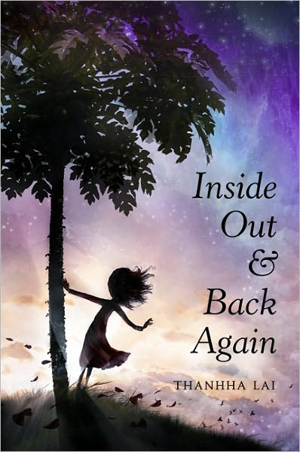
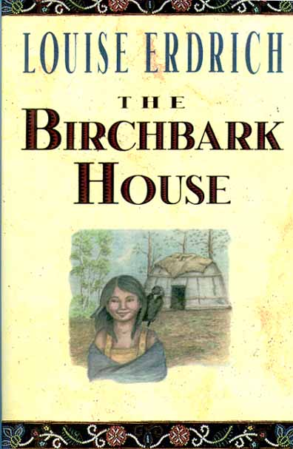
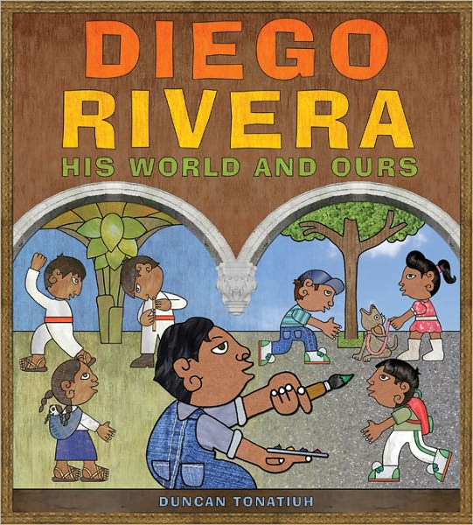
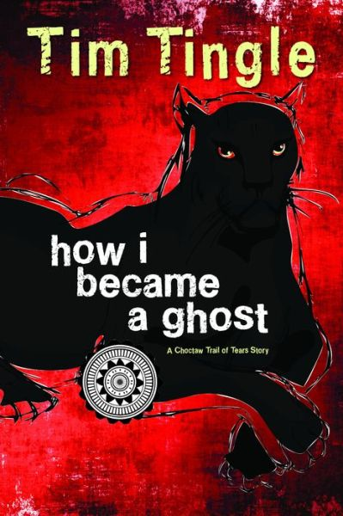
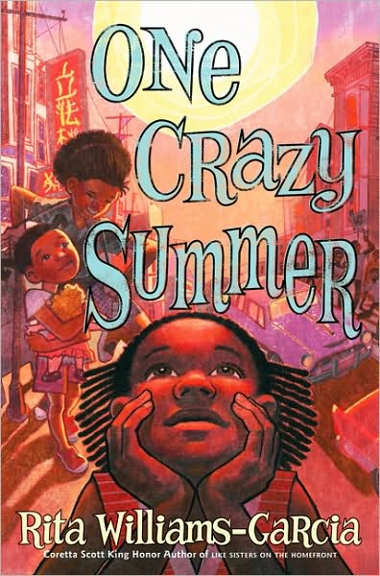
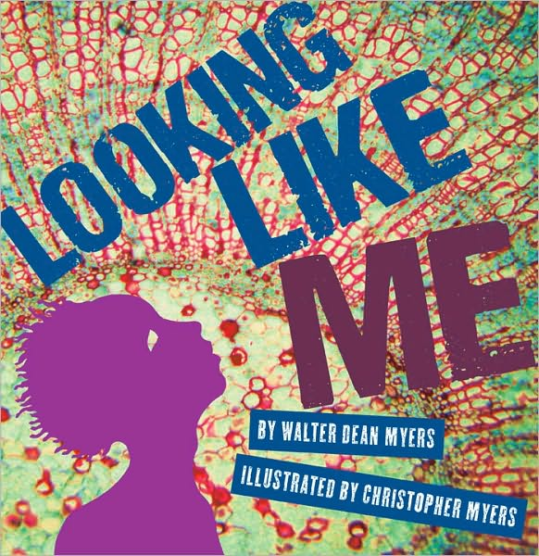
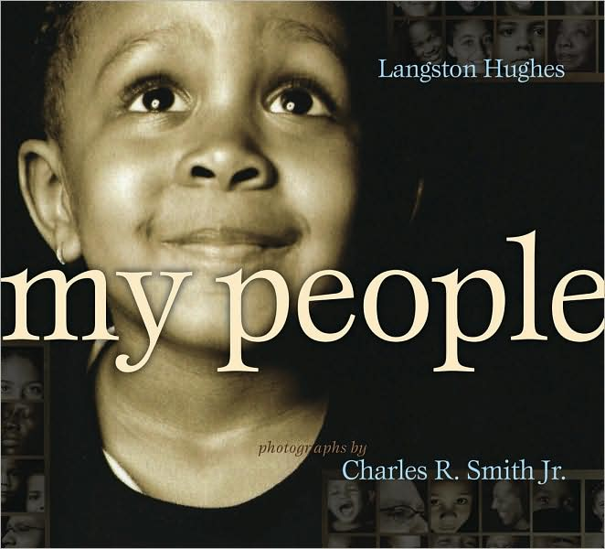
50 Multicultural books every child should know
http://ccbc.education.wisc.edu/books/detailListBooks.asp?idBookLists=42

Slide 17
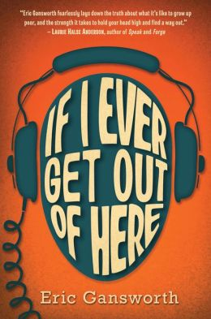

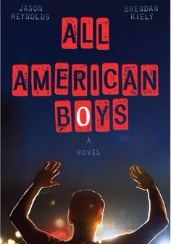

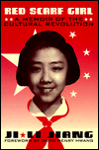
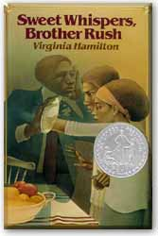
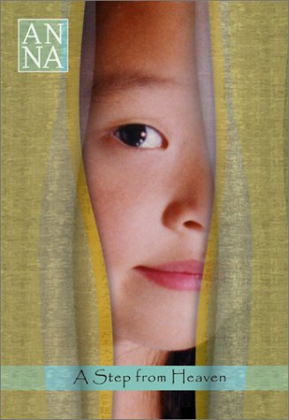
30 Multicultural books every TEEN should know
CHECK OUT CCBC’S ADVANCED SEARCH FEATURE
http://ccbc.education.wisc.edu/books/detailListBooks.asp?idBookLists=42

Slide 18
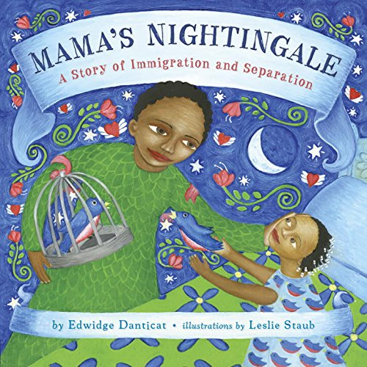

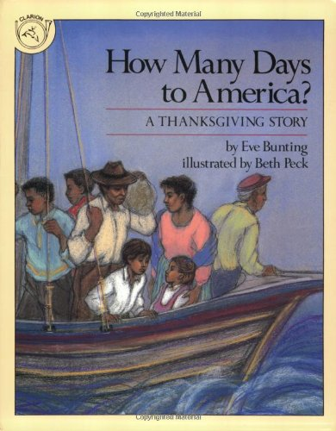
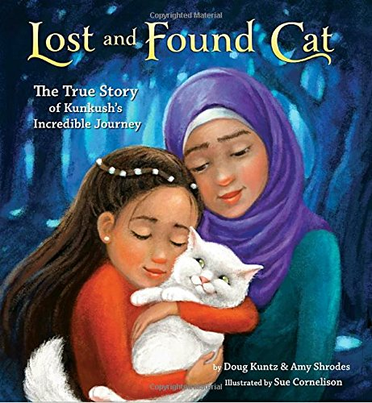
15 kids books celebrating immigration
WHOLE SECTION ON IMMIGRATION BOOKS
http://mom-gene.com/2017/09/18/15-kids-books-thaimmigration/
Notes:
Move from one country to another can be hard on kids.
15 books to help your child learn what it’s like to move to a new land.
Also teach empathy to kids in classroom who need to welcome a stranger.

Slide 19

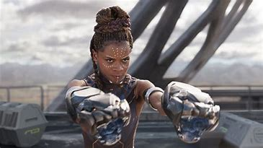
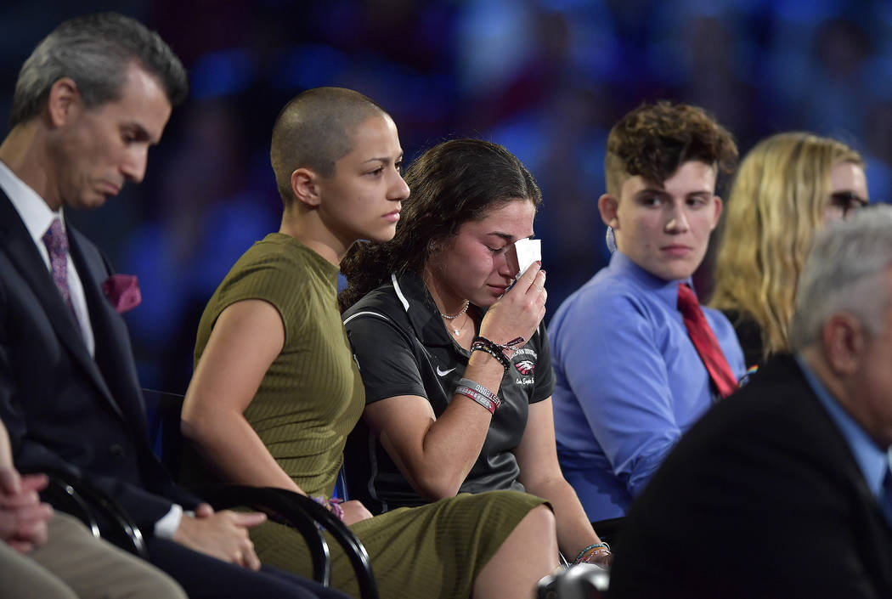
A SEA CHANGE IS UNDERWAY.

Slide 20
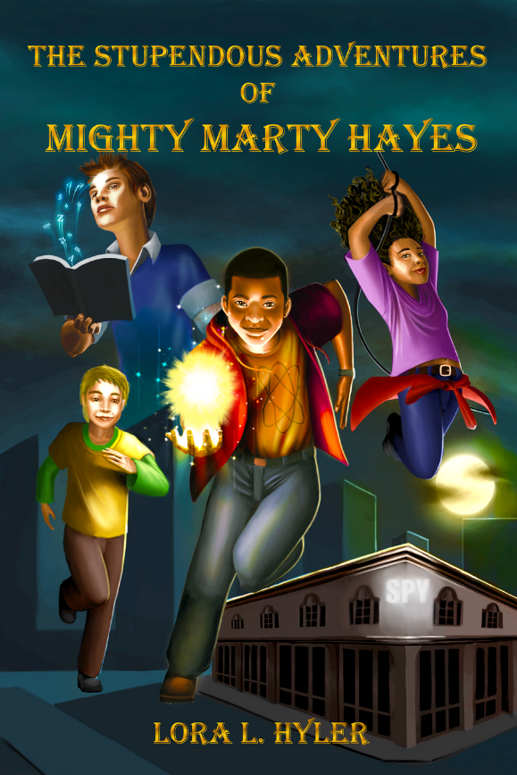
The stupendous adventures of mighty marty hayes
“An African-American tween uses espionage skills and superpowers in this debut middle-grade novel. Seventh-grader Marty Hayes is excited to work with the world-renowned CRISPR-Cas9 gene editing kit in science class. But things go awry…This rousing book with engaging characters should appeal to readers who enjoy adventurous superhero sagas. A thrilling tale with series potential that highlights science, spying, history, and the importance of family.
- Kirkus Reviews

Slide 21
Lora L. Hyler www.lorahylerauthor.com
Gmail: lorahyler@gmail.com

